Slide 1
Purchase pattern Analysis Market Basket analysis using apriori algorithm PTID-CDA-APR-26-1290 Kumari Akanksha

Slide 2
Business problem statement
The challenge is to analyze retail transaction dataset to unveil relationships between products. This includes understanding customer purchasing behavior, identifying frequently co-occurring products, and deriving actionable recommendations to enhance sales strategies and customer satisfaction.

Slide 3
Project Objectives
Perform exploratory data analysis
Clean and transform transaction data
Implement Apriori algorithm
Generate business recommendation
The Stack:
Data Layer: MySQL
Processing & Modeling: Python (pandas, mlxtend - Apriori Algorithm)
Business Intelligence: Power BI

Slide 4
Dataset overview
Table : Mytable
Database : Purchase_pattern_analysis
Columns : BillNo , Itemname , Quantity , Date , Price , CustomerID , Country
Retail Transaction data

Slide 5
Project Workflow
[1. Data Ingestion ] [2. Pipeline & EDA] [3. Modelling(Apriori) ] [4. Data Export ] [5. BI & Insights ]
Connected directly to production MySQL Database. Extracted raw historical transactional records (Invoice IDs, Product Descriptions, Quantities, and Timestamps). | Established Python-MySQL pipeline using mysql-connector Conducted data cleaning (null handling) , outlier detection on transaction volumes. Performed (EDA) to identify top-selling items and purchase trends. | Implemented the Apriori Algorithm to extract frequent itemset. Generated Association Rules to uncover hidden product relationships. Evaluated rules based on key statistical metrics: Support, Confidence, and Lift. | Processed, transformed, and structured the final association rules matrix in Python. Extracted the clean, high-value data into a optimized CSV file format, ready for business intelligence tools. | Imported the processed CSV into Power BI. Built an dashboard visualizing product clusters and rule strengths. Translated data patterns into actionable business insights (e.g., cross-selling strategies, shelf placement, and bundling).

Slide 6
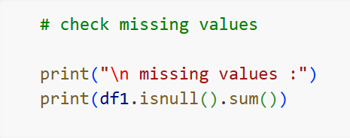
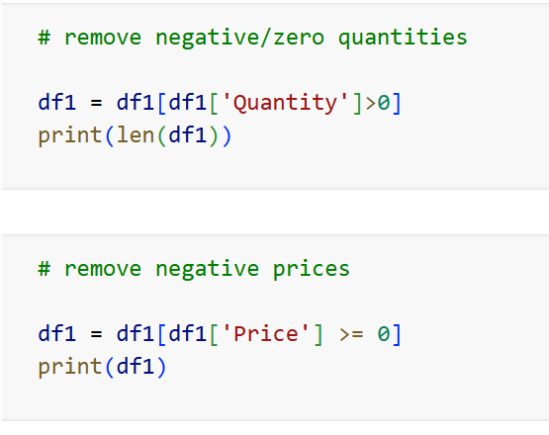
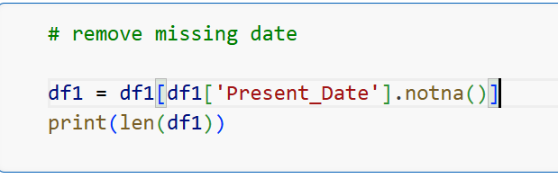
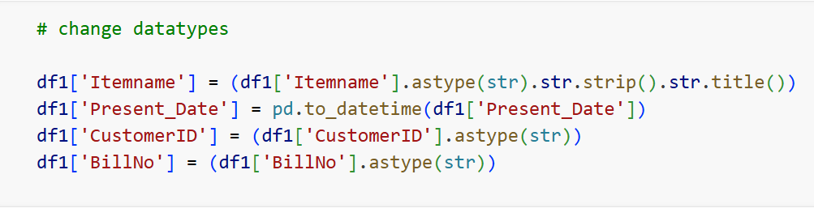
Data Cleaning
Handle missing customer ID , null values of itemnames
Change datatype of BillNo , Customer ID column from int to str
Standardized date format
Removed Duplicate records
Removed invalid quantities , itemnames , prices , missing dates

Slide 7
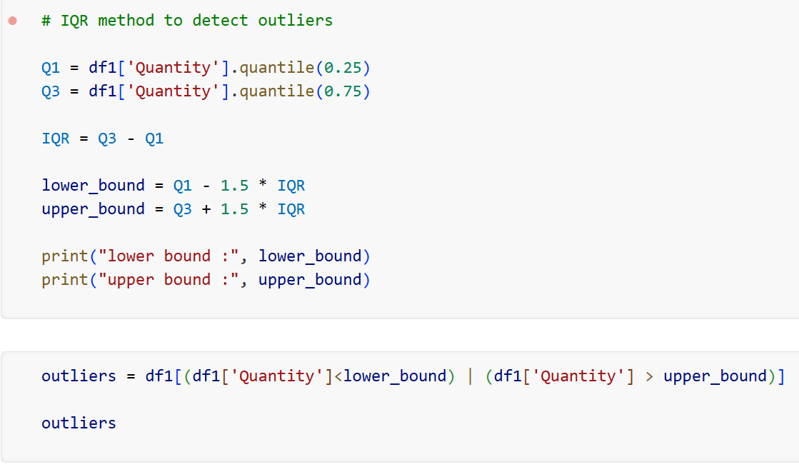
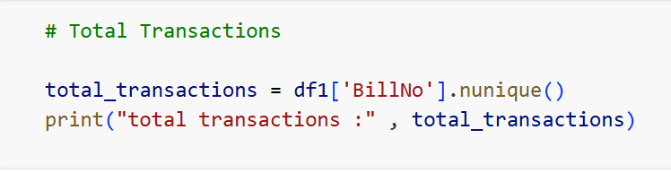
Exploratory data analysis
Outlier Detection performed on huge quantity entered manually
Country wise sales trend explored
Transaction size analyzed
Top selling products identified
Feature engineering [ created revenue column , date columns ]

Slide 8
Market Basket Analysis Using apriori
Market Basket Analysis (MBA) is a data mining technique used to uncover relationships between items that customers purchase together. Retailers use these insights for cross-selling, product bundling, and optimizing store layouts
How the Apriori Algorithm Works :
The algorithm uses a "bottom-up" approach, which states that if an itemset is frequent, all its subsets must also be frequent.
1. Set Thresholds: Define a minimum Support and Confidence.
2. Join Step: Generate frequent 1-itemsets then combine them to create 2-itemsets, 3-itemsets, and so on.
3. Prune Step: Discard any itemset that falls below the minimum Support threshold to save computational time.
4. Rule Generation: From the final frequent itemsets, generate association rules that meet the minimum Confidence threshold

Slide 9
Association rule framework
Metric Type | Definition | Applied threshold
Support | Probability that the choose items are bought together Support (A) = Transactions containing A Total Transactions | >= 2.0 % of total transactions
Confidence | Likelihood that item B is bought if item A is in the basket Confidence (A -> B) = Support (A B ) Support (A) | >= 50% probability
Lift | Strength of rule over independent purchase assumptions Lift ( A -> B) = Confidence (A -> B) Support (B) | >= 2 score

Slide 10
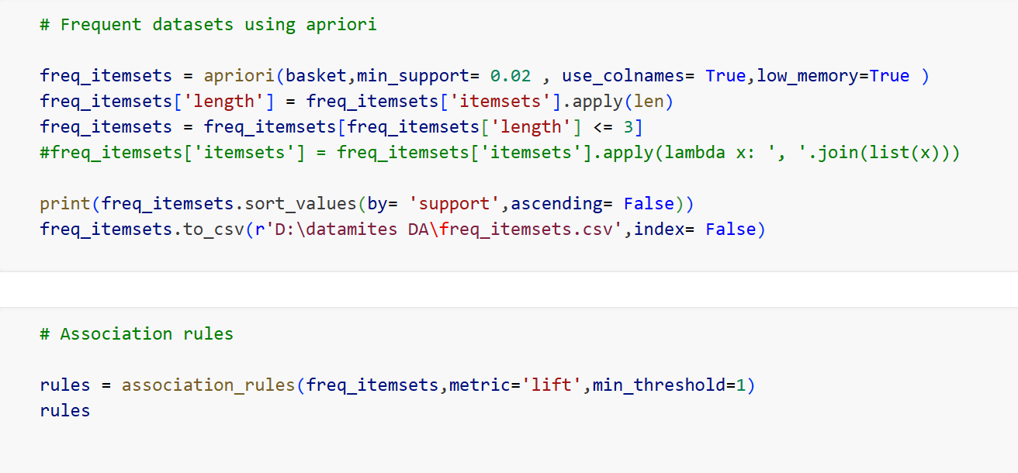
Market Basket Analysis
Created transaction product matrix
Applied one hot encoding
Generated frequent itemsets (apriori algorithm)
Calculated support, confidence ,lift (association rules)

Slide 11
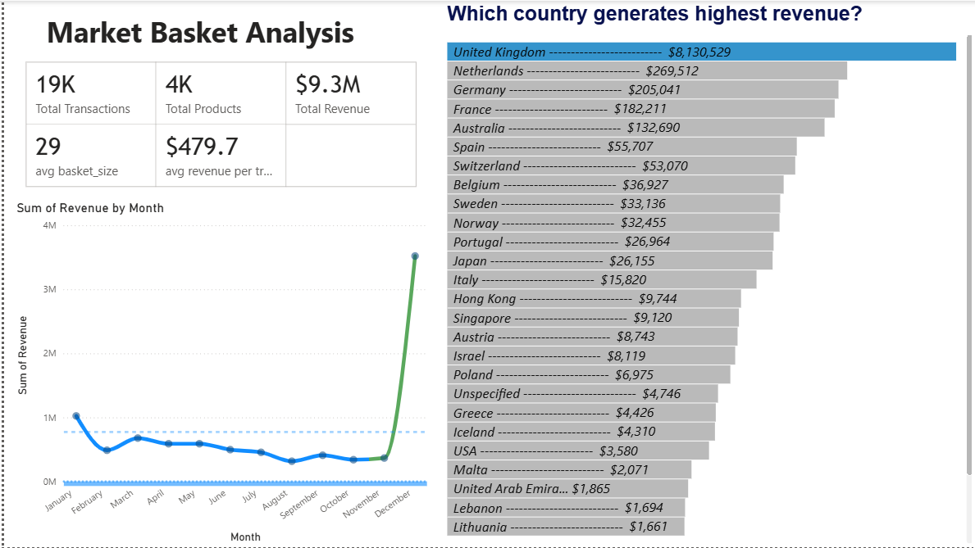
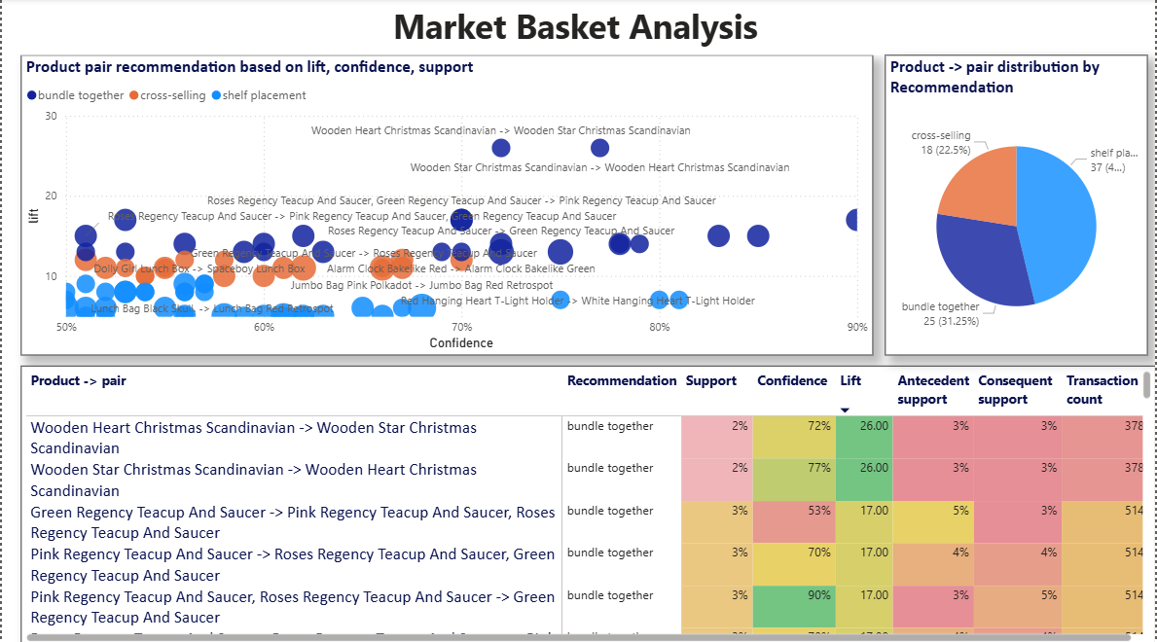
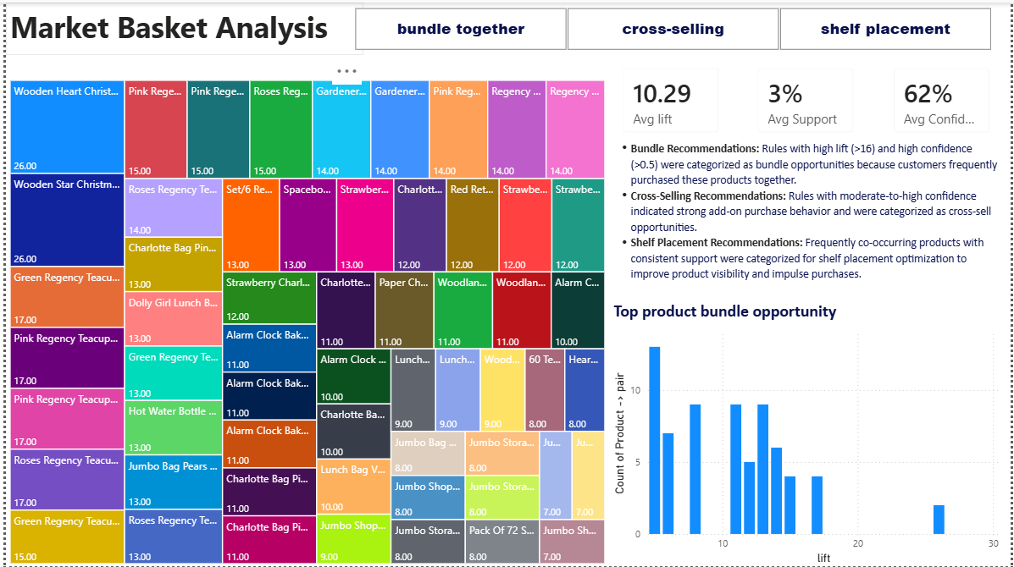
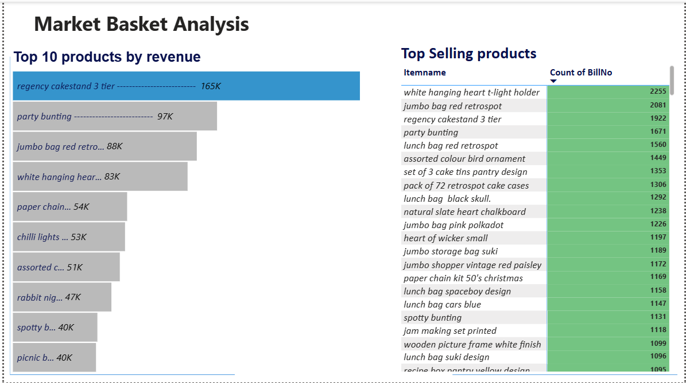
Interactive dashboard
Designed a responsive business reporting panel by connecting processed CSV data into a detail dashboard. Enables executive team to see products that can be recommended in cross-selling , bundling , shelf placement.

Slide 12
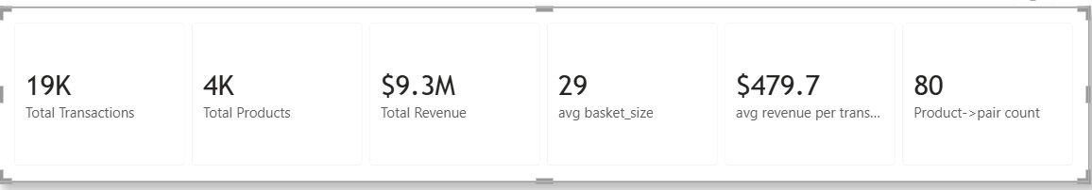
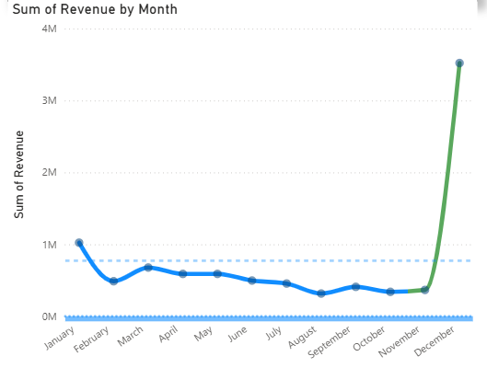
Dashboard Overview
Highlight core data health metrics—Total Unique Transactions Analyzed, Distinct Products, Total revenue and Total product pair Generated above minimum thresholds.
Nov & Dec contributes the most revenue

Slide 13
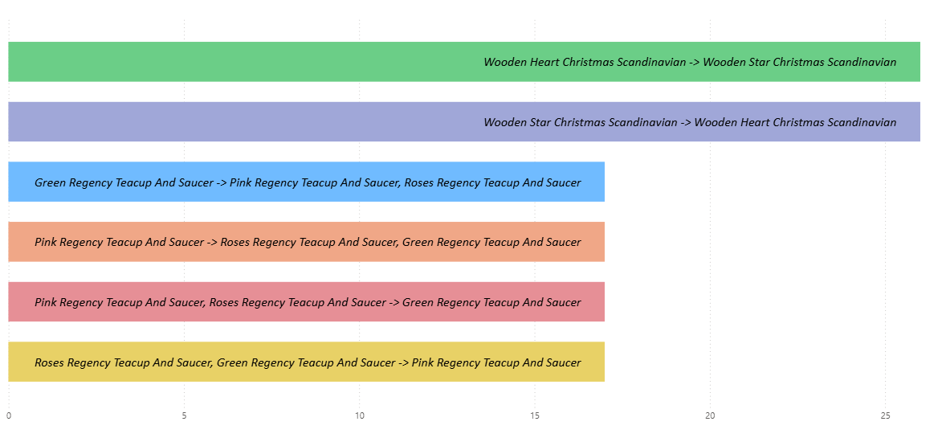
Highest Lift Associations
A high lift score indicates that these items are purchase together significantly more often than expected if they were random choices, representing direct natural bundle patterns

Slide 14
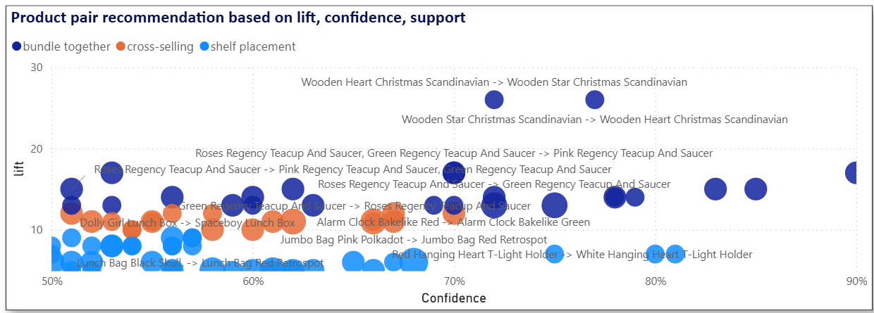
Explains rule strength:
X-Axis (Confidence): Predictive certainty
Y-Axis (Lift): The strength of the rule compared to random chance.
Size (support): Operational frequency
Color : Product pair recommendation

Slide 15
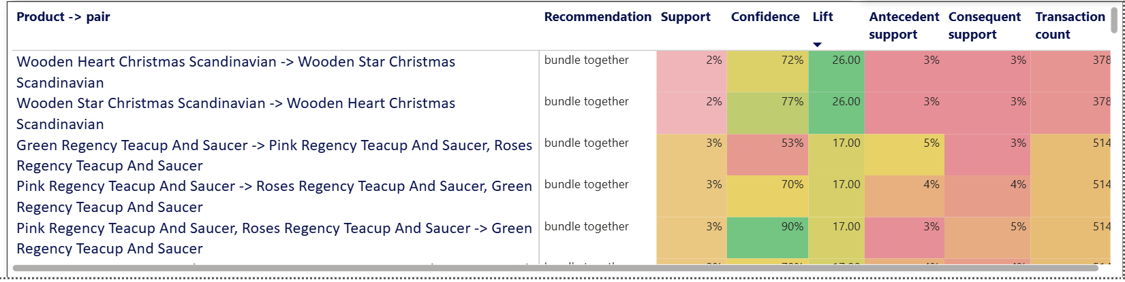
Antecedent vs. Consequent Matrix:
A clean grid that lets retail category managers pick an item on the left based on support, confidence , lift metrics.

Slide 16
Key insights :
Product Category Cluster | Data Patterns Found | Statistical Evidence
The Regency Teacup Collection | Green, Pink, and Roses Regency Teacup and Saucers have massive co-purchase affinity. When bought with a Regency 3-Tier Cake stand, buying confidence spikes significantly | 78% to 79% Confidence Lift up to 17x higher than random chance.
The Alarm Clock Bake like Series | Customers buying one color variant (Green) are highly likely to simultaneously purchase alternative colors (Red or Pink). | 62% to 66% Confidence Lift: 10x to 11x
The Jumbo Storage Bag Line | Jumbo Bag Pink Polkadot and Vintage Red Paisley strongly drive the purchase of the flagship Jumbo Bag Red Retrospot. | 80% to 81% Confidence Lift: 7x to 8x
The Charlotte Gift Bag Collection | Multi-buying behavior observed across thematic patterns (Pink Polkadot, Suki Design, Red Retrospot). | 55% to 70% Confidence Lift: 11x to 13x

Slide 17
Business Recommendations:
Smart Product Bundling (Increase Average Order Value):
The "High-Tea" Bundle: Create an all-in-one "Regency Tea Party Set" containing the 3-Tier Cake stand along with the Green and Roses Teacups. Price the bundle slightly lower than individual items combined to liquidate inventory of slower-moving variants.
The Color-Way Bundle: Offer a "Mix & Match Alarm Clock Duo" discount. Since there is a 62% confidence that a Green clock buyer will buy a Red one, incentivize the second unit at a 15% discount.
2. Tactical Cross-Selling & Digital UX Carousels:
Configure the e-commerce recommendation engine so that when a user adds a Charlotte Bag Pink Polkadot to their online cart, the Red Retrospot Charlotte Bag automatically populates as a "Frequently Bought Together" pop-up.
High-Confidence triggers: Use the 80% confidence rule on Jumbo bags to trigger post-purchase email flows or checkout-page upsells.
3. Physical Shelf Placement (Brick & Mortar):
Anchor Strategy: Place the highly popular Regency 3-Tier Cakestand as an eye-level aisle anchor, flanked immediately to the left and right by the Green, Pink, and Roses Teacup collections.
Thematic Vertical Ribboning: Display the Charlotte Gift Bag variations vertically adjacent to one another, making it seamless for a customer to grab multiple matching or complementary designs.

Slide 18
Thank you !

